Slide 1
Machine Learning with LA County Restaurant Violations
Project By Group E
Vignesh Srinivas
Natya Srinivasan
Abhishek Shah

Slide 2
Table of Contents
Hardware Specification
Dataset Information
Analyzing and Transforming Data
Removing Outliers
Machine Learning – Regression
Machine Learning – Classification
Summary
Observations

Slide 3
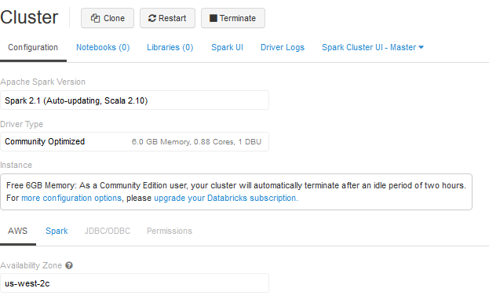
Hardware Specifications
Apache Spark Version – Spark 2.1 (Auto-updating, Scala 2.10)
Memory – 6GB Memory , 0.88 Cores, 1 DBU
File System – DBFS (Data Bricks File System)

Slide 4
Dataset Information
Name – Restaurant Violations in LA County
Size – 178 MB
Format – CSV
Source - https://data.lacounty.gov/Public-Health/LOS-ANGELES-COUNTY-RESTAURANTS-AND-MARKETS-VIOLATI/b9ey-v6ni
Years – 2014, 2015, 2016

Slide 5
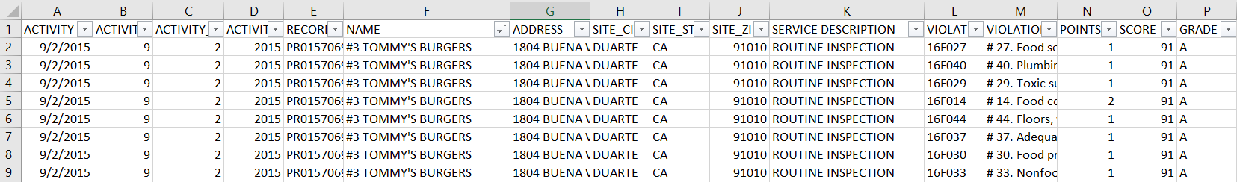
Analyzing the Data
A Restaurant which was inspected on 9/2/2015 has made 8 violations and got a total score of 91 and their grade is A. Their total penalty points is 9. Each Violations have penalty points of either 0,1,2 or 4.
GRADE | SCORE RANGE
A | 90 – 100
B | 80 – 89
C | 70 – 79
SC | < 69

Slide 6
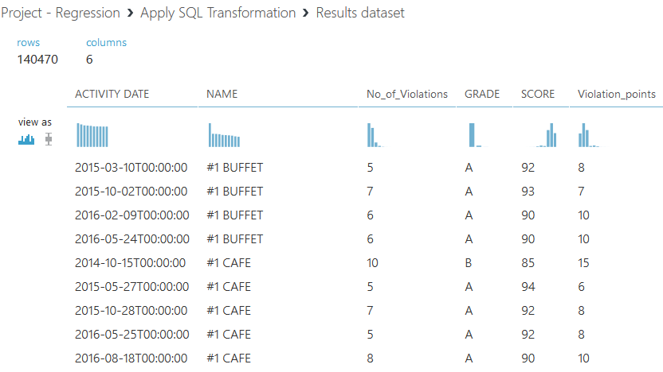
Transforming Data
SELECT [ACTIVITY DATE],NAME, count([VIOLATION CODE]) as No_of_Violations,grade, score, sum(points) as Violation_points FROM t1 where SCORE >= "60" group by NAME,[ACTIVITY DATE],grade,score;

Slide 7
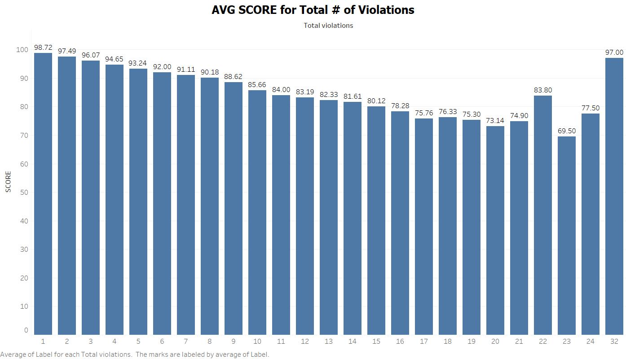
Analyzing the Data Trend
Comparing the Average Score of all restaurants with the No. of violations they have made.
If Score is HIGH , No. of Violation they have made is LESS .
But for Total Violations > 21 , there are some inconsistencies in data. (outliers)
32 violation yields score of 97, which is incorrect.

Slide 8
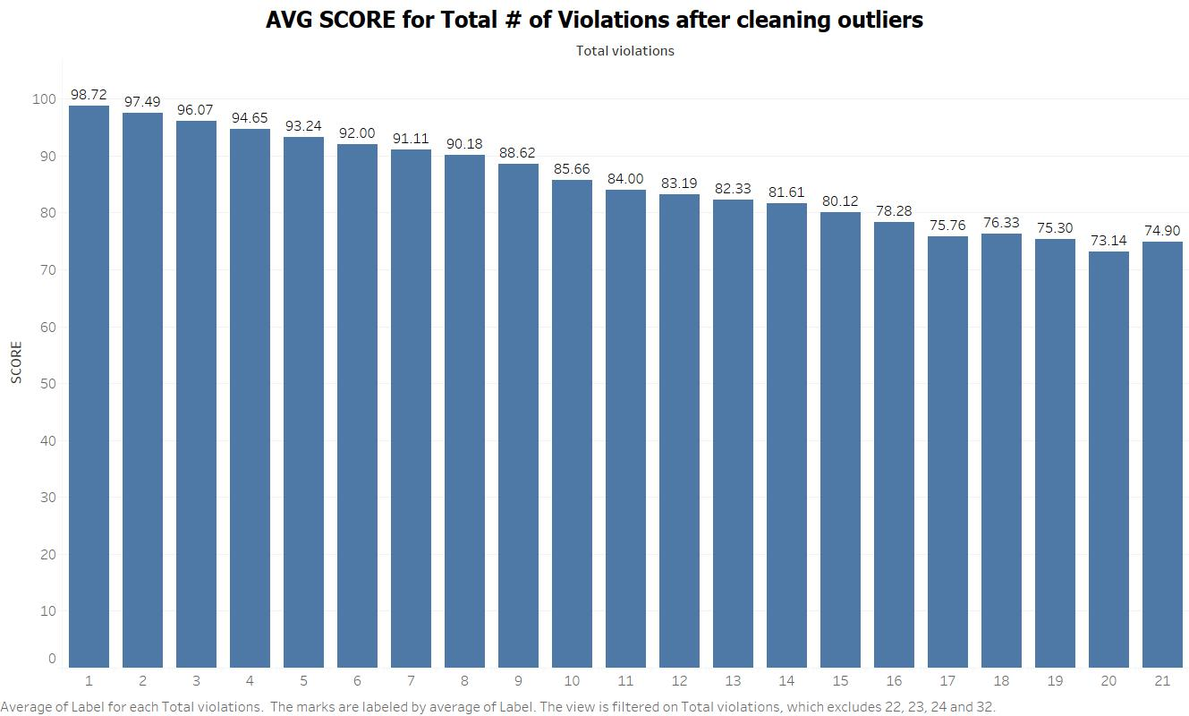
Removing the Outliers
The outliers (Total Violations > 21), has been removed using a SQL where condition.
select * from t1 where Total_Violations <= '21'

Slide 9
Machine Learning - Regression
Goal - Predicting the Score of a Restaurant based on Total Violations they have made.
Features – Total_Violations (Total Violation counts for a restaurant on a day of inspection)
Label – Score (Final Score of a restaurant)
Algorithms used:
Azure ML | Spark ML
Linear Regression | Linear Regression
Boosted Decision tree Regression | Decision tree Regression

Slide 10
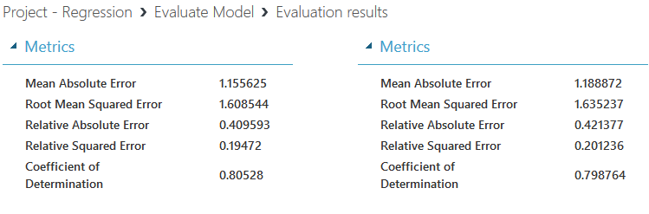
Machine Learning – Regression (Azure ML)
Evaluation Metric : RMSE (Root Mean Squared Error)
Split – 70% for Train and 30% for Test.
Accurate Model – Boosted Decision Tree Regression. RMSE = 1.608
Boosted Decision Tree Regression vs Linear Regression

Slide 11
Machine Learning – Regression (Spark ML)
Evaluation Metric : RMSE (Root Mean Squared Error)
Split – 70% for Train and 30% for Test
Accurate Model – Decision Tree Regression. RMSE = 1.609

Slide 12
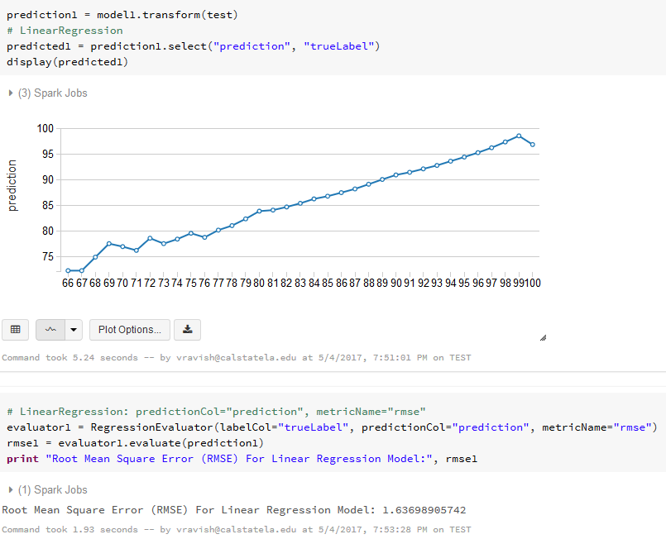
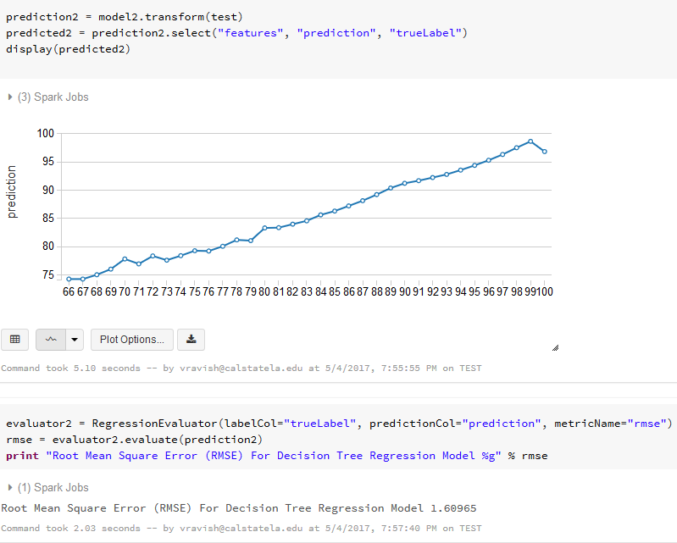
Machine Learning – Regression (Spark ML)

Slide 13
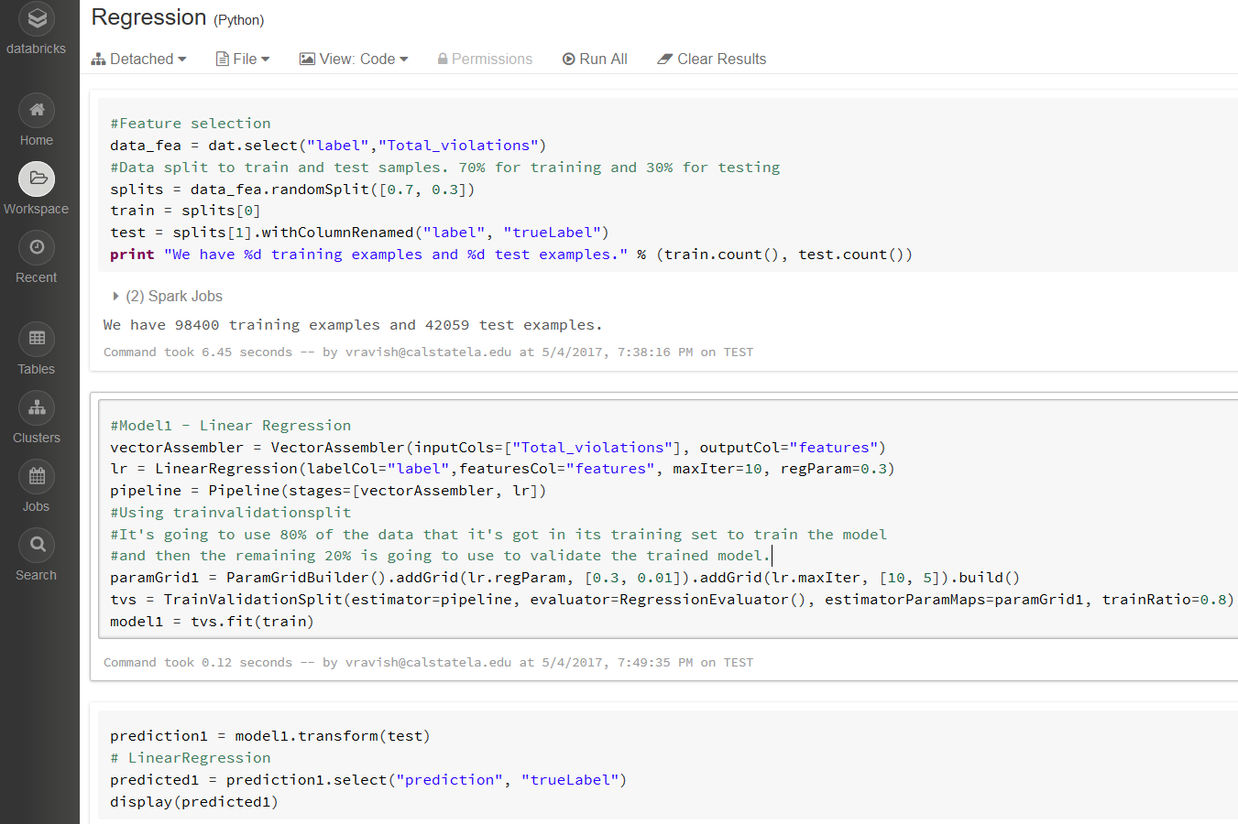
Machine Learning – Regression (Spark ML)
Overview of iPython Notebook in Databricks. Training, testing and evaluating the model with Train Validation Split.

Slide 14
Machine Learning - Classification
Goal - Predicting the Grade of a Restaurant based on Total Violations and their penalties.
Features – Total_Violations, Penalty_points
Label – Grade (Final Grade of a restaurant)
Algorithms used:
Azure ML | Spark ML
Multi-class Decision Jungle | Decision Tree Classifier
Multi-class Decision Forest | Random Forest Classifier

Slide 15
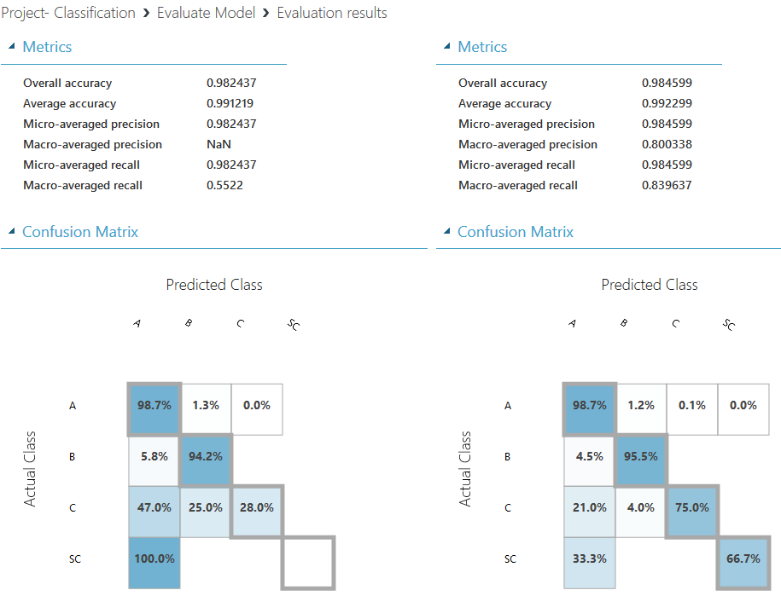
Machine Learning – Classification (Azure ML)
Evaluation Metric :
-Average accuracy
-Confusion matrix
Split :
- 70% for Train and 30% for Test
Accurate Model :
- Multi-class Decision Forest
Accuracy = 99.2%
Recall = 83%
Multiclass Decision Jungle Vs Multiclass Decision Forest

Slide 16
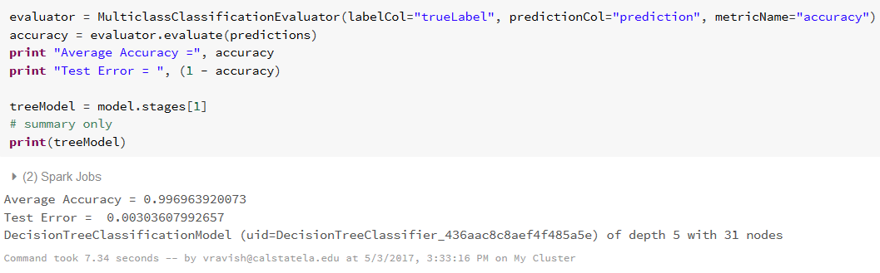
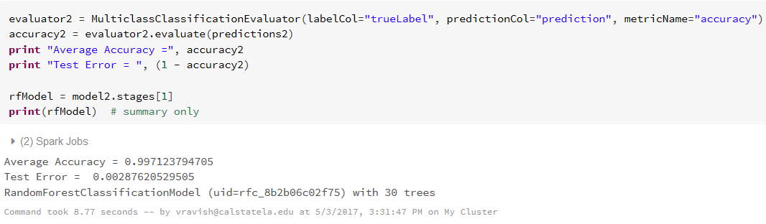
Machine Learning – Classification (Spark ML)
Evaluation Metric :
- Average accuracy
Split :
- 70% for Train and 30% for Test
Accurate Model :
Random Forest Classification
Accuracy = 99.7%

Slide 17
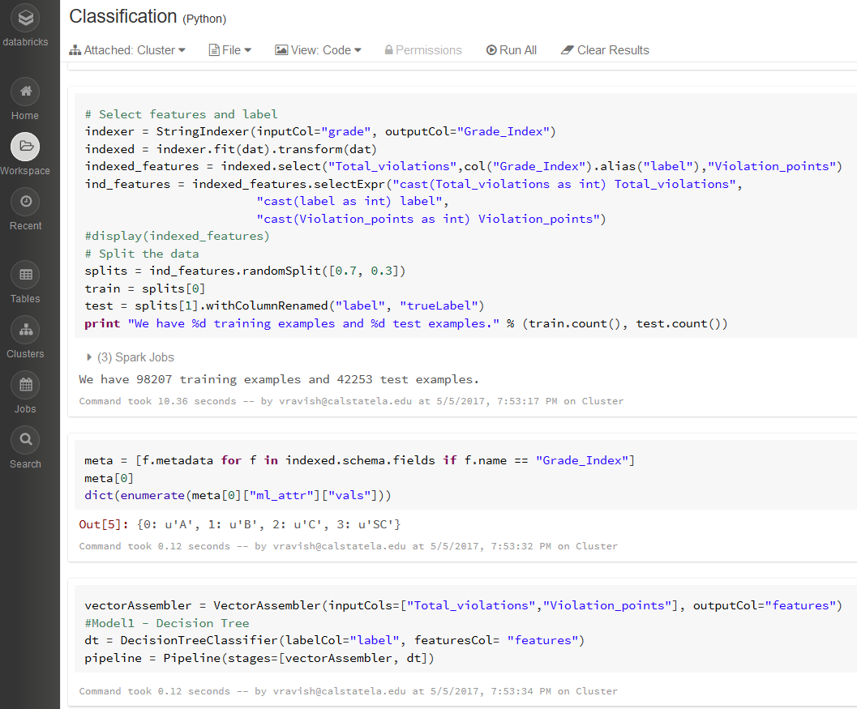
Machine Learning – Classification (Spark ML)
Overview of iPython Notebook in Databricks. Using Stringindexer() to create index for Grades (Label).

Slide 18
Overview of Accurate Models
Regression | Classification
Azure ML : Boosted Decision Tree | Azure ML : Multi-class Decision Forest
RMSE : 1.608 | Accuracy : 99.2%
Spark ML : Decision Tree | Spark ML : Random forest Classification
RMSE : 1.609 | Accuracy : 99.7%

Slide 19
Summary
The LA County Restaurant Grade/Score predictions using Regression and Classification are compared in both Azure ML and Spark ML (Databricks).
On comparison, the predictions were almost similar in both Azure ML and Spark ML.

Slide 20
Observations
Feature prediction and Data preprocessing was easy in Azure ML on comparison with Spark ML.
Wide range of Multi-class classification algorithms are available in Azure ML, whereas Spark ML consists of only 2 algorithms.
Evaluation Metrics like Confusion matrix is not available for Multi-class classification in Spark ML.
Data visualization is easier in Spark ML.

Slide 21
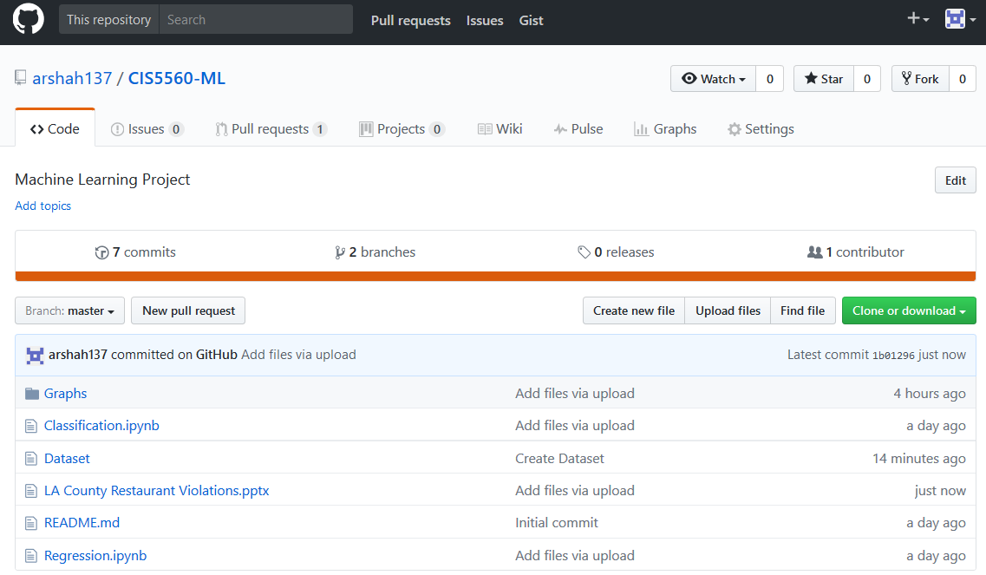
GitHub
https://github.com/arshah137/CIS5560-ML

Slide 22
References
http://stackoverflow.com/questions/33636944/preserve-index-string-correspondence-spark-string-indexer
https://docs.microsoft.com/en-us/azure/machine-learning/machine-learning-evaluate-model-performance

Slide 23
Thank you
Question and Answer session

